Slide 1


RAJARAMBAPU INSTITUTE OF TECHNOLOGY, RAJARAMNAGAR

Slide 2

INDUSTRIAL TRAINING PRESENTATION
Presented By:
Sakshi Ashok Gavade
[2117400226]
Topic:
SMS Scam Detection

Slide 3
INTRODUCTION
Introduction Of Company:
Domain Computer Education was founded in January 2008 in Kolhapur District & in July 2013 Established center in Sangli District.
Domain Computer Education is one of the well known leading Institute in Kolhapur & Sangli District for the Industry Oriented Global IT Certification Training & Placement Services.
Founders Of the Domain Computer Education Sangli Office:
Mr. SagarTondale
Mrs. Vinayashree Akkalkot

Slide 4
Python:
Dgfjssss INTRODUCTION
Python is a computer programming language often used to build websites and software, automate tasks, and conduct data analysis. Python is a general-purpose language, meaning it can be used to create a variety of different programs and isn't specialized for any specific problems.
Artificial Intelligence:
Artificial intelligence is the capability of a computer system to mimic human cognitive functions such as learning and problem-solving. Through AI, a computer system uses math and logic to simulate the reasoning that people use to learn from new information and make decisions..

Slide 5
OBJECTIVE
Prediction of SMS spam has been an important area of research for a long time.
The goal is to apply different machine learning algorithms to SMS spam classification problem, compare their performance to gain insight.
Further explore the problem, and design an application based on one of these algorithms that can filter SMS spams with high accuracy.

Slide 6
REQUIREMENTS
Hardware :
Software:
The hardware requirements may serve as the basis for a contract for the implementation of the system and should therefore be a complete and consistent specification of the whole system.
PROCESSOR : Intel I5
RAM : 4GB HARD
DISK : 40 GB
The software requirements document is the specification of the system. It should include both a definition and a specification of requirements.
PYTHON IDE : Anaconda Jupyter Notebook PROGRAMMING
LANGUAGE : Python

Slide 7
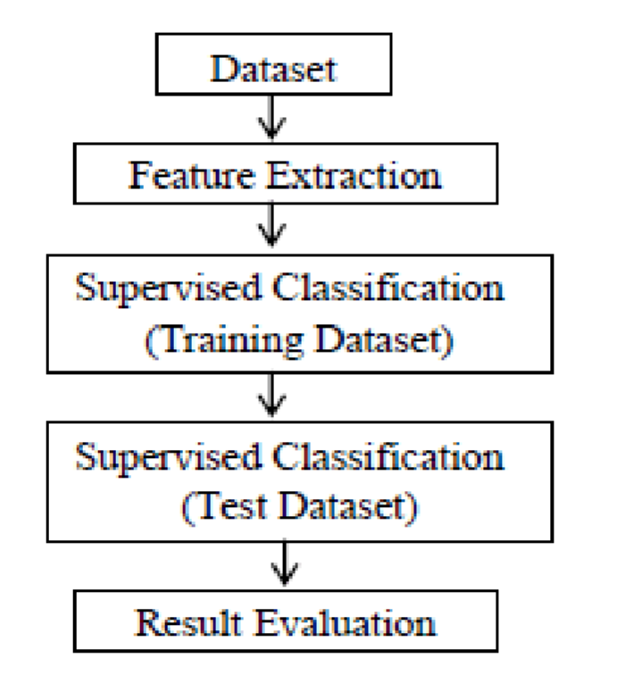
DATA FLOW DIG
Data flow diagrams are used to graphically represent the flow of data in a business information system. DFD describes the processes that are involved in a system to transfer data from the input to the file storage and reports generation. Data flow diagrams can be divided into logical and physical. The logical data flow diagram describes flow of data through a system to perform certain functionality of a business. The physical data flow diagram describes the implementation of the logical data flow.

Slide 8
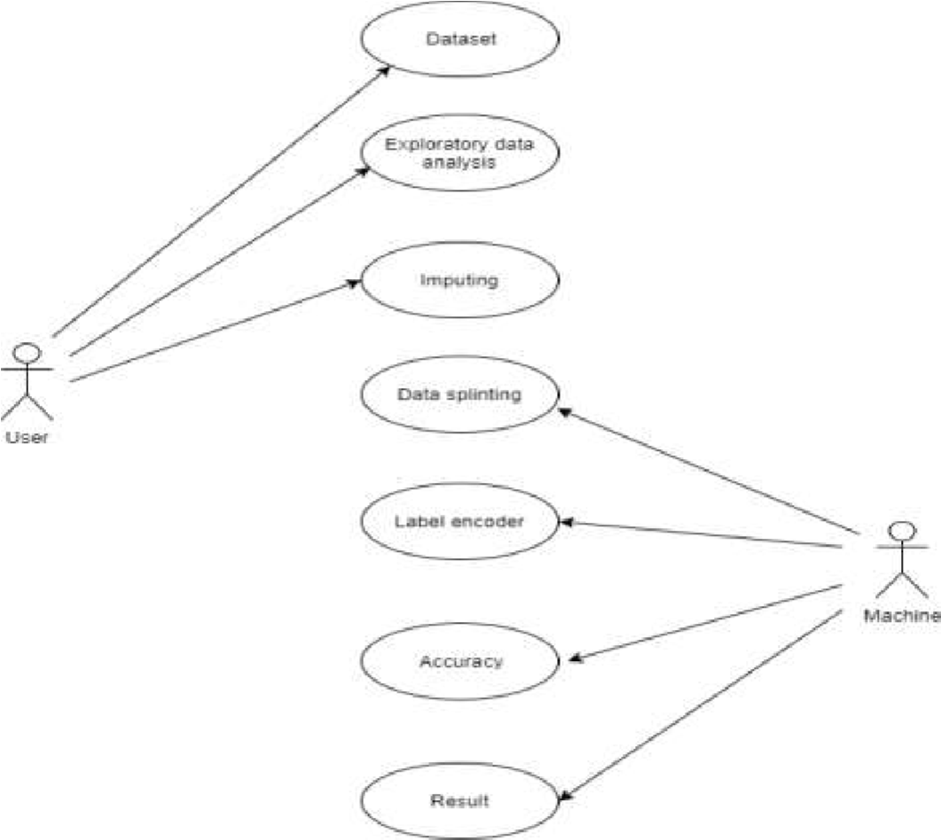
USE CASE DIG
Use case diagrams identify the functionalities provides by the use cases, the actors who interact with the system and the association between the actors and the functionalities.

Slide 9



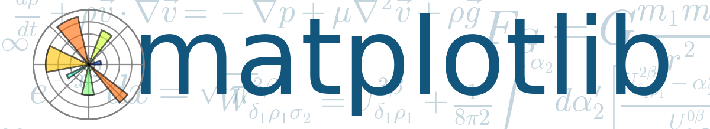
SOFTWARE USED
a. Python
b. Numpy
c. Pandas
d. Matplotlib

Slide 10
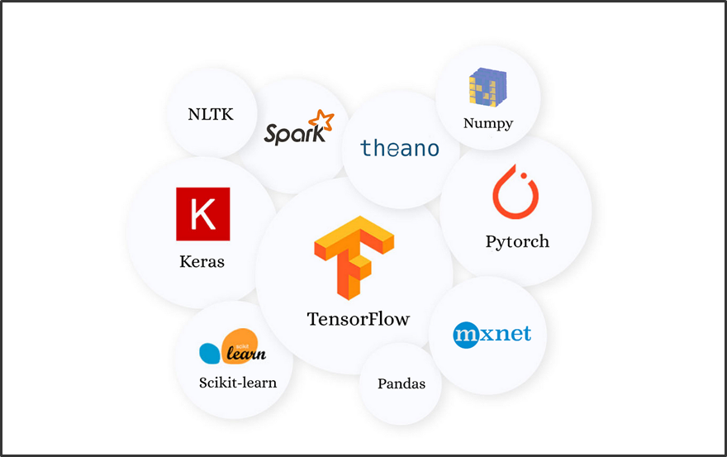
IMPLEMENTATION
We will import all the required libraries :
import numpy as np
import pandas as pd
import matplotlib.pyplot as plt
import seaborn as sns
import tensorflow as tf
from tensorflow import keras
from tensorflow.keras import layers

Slide 11
Loading the Data :
Load the Dataset using pandas function .read_csv()
# Reading the data
df = pd.read_csv("/content/spam.csv",encoding='latin-1’)
df.head()

Slide 12
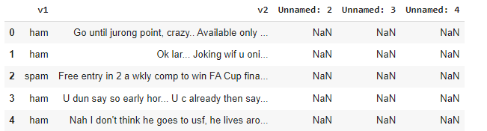
Understanding the Data :
Lets, Understand the data
As we can see that the dataset contains three unnamed columns with null values. So we drop those columns and rename the columns v1 and v2 to label and Text, respectively. Since the target variable is in string form, we will encode it numerically using pandas function .map().

Slide 13
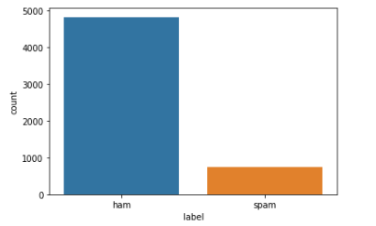
Code:
Let’s visualize the distribution of Ham and Spam data.
sns.countplot(x=df['label'])
plt.show()
Output after the above data preprocessing :
The ham data is comparatively higher than spam data, it’s natural. Since we are going to use embedding's in our deep learning model, we need not balance the data.

Slide 14
CONCLUSION
The SMS spam message problem is plaguing almost every country and keeps increasing without a sign of slowing down as the number of mobile users increase in addition to cheap rates of SMS services. Therefore, this paper presents the spam filtering technique using various machine learning algorithms. In conclusion, mitigating SMS fraud is crucial to protect users' privacy.

Slide 15
FUTURE SCOPE
Future scope of this project will involve adding more feature parameter. The more the parameters are taken into account more will be the accuracy. The algorithms can also be applied for analyzing the contents of public comments and thus determine patterns/relationships between the customer and the company.

Slide 16
Thanks!

